Slide 1
Young Emerging Professional LITE - Starter Pack

Slide 2
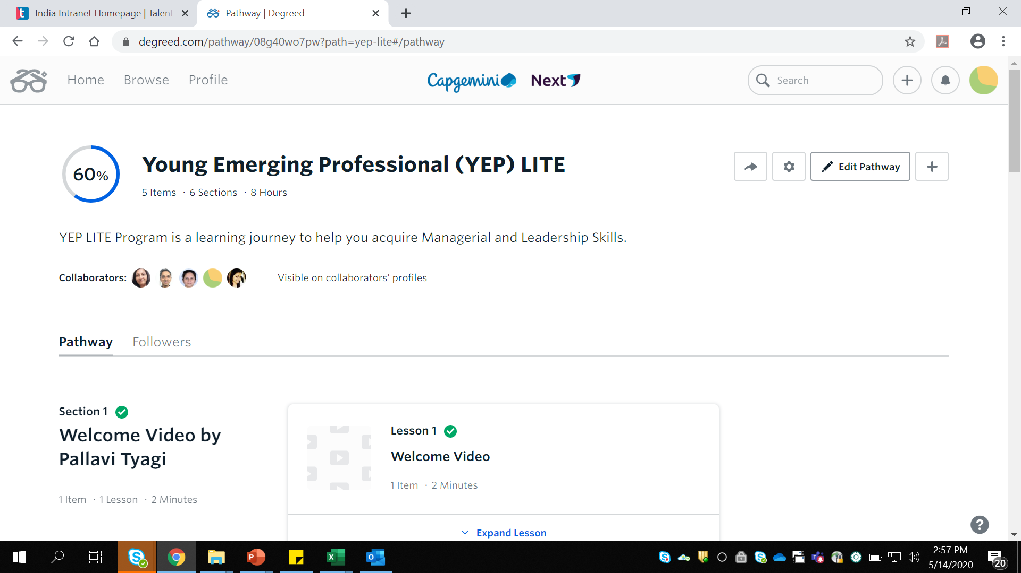
Step 1 - Click on the Degreed link(Ref - Email) and then Click Follow
CLICK HERE

Slide 3
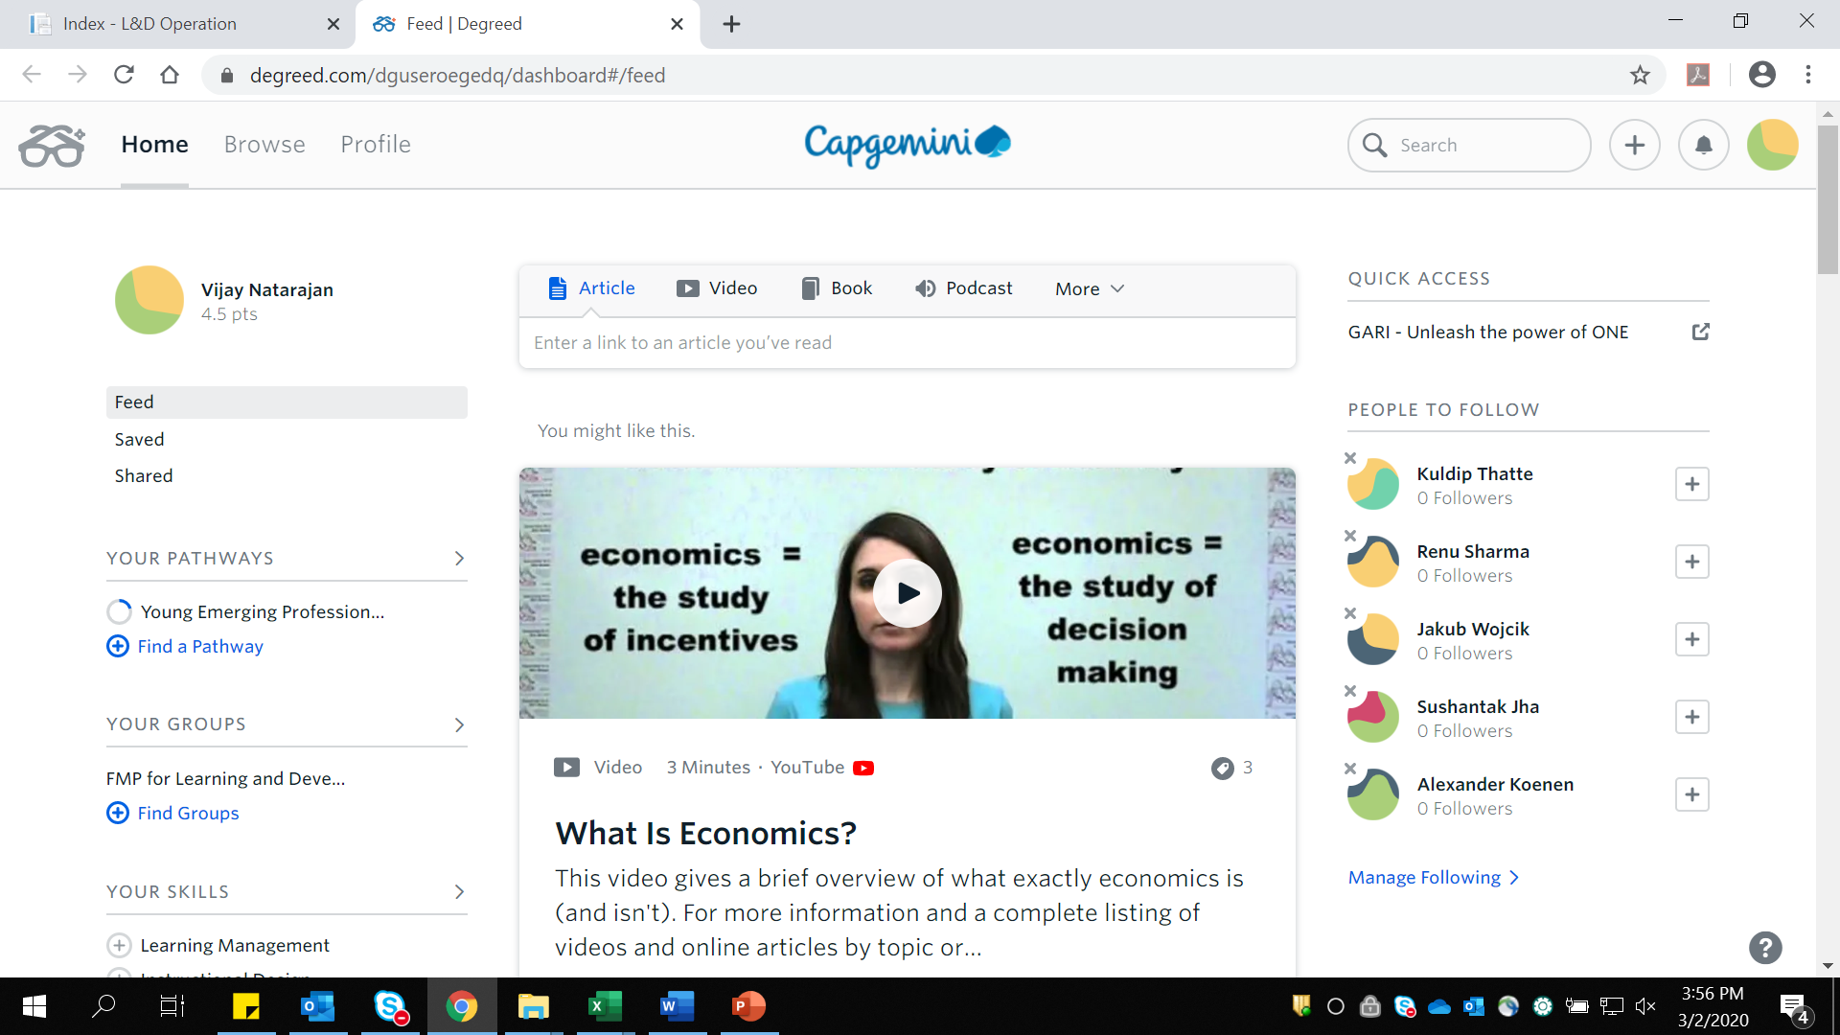
Step 1 – Click on Home and create a Personal Profile
CLICK HERE

Slide 4
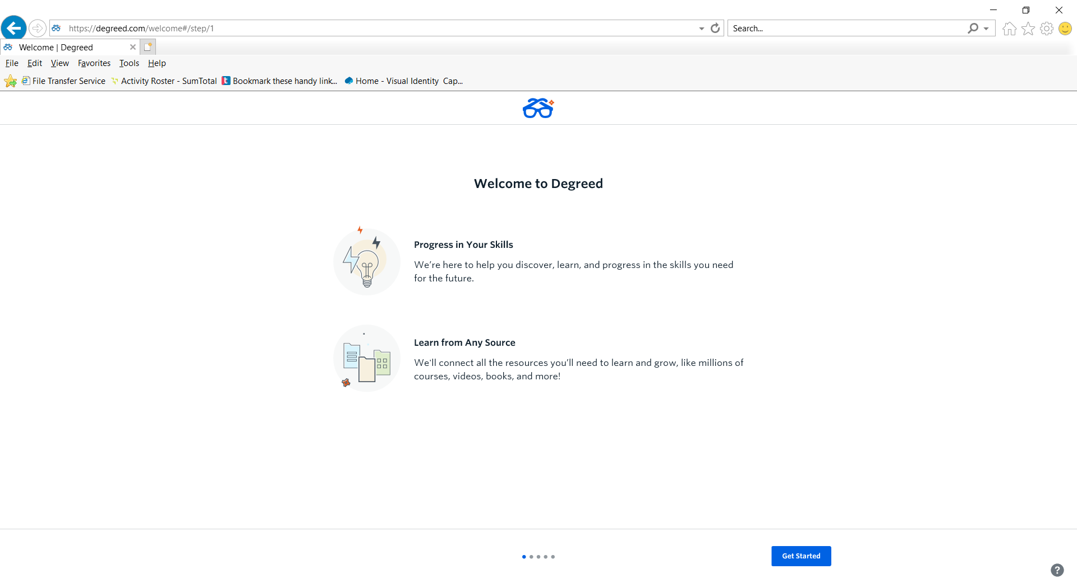
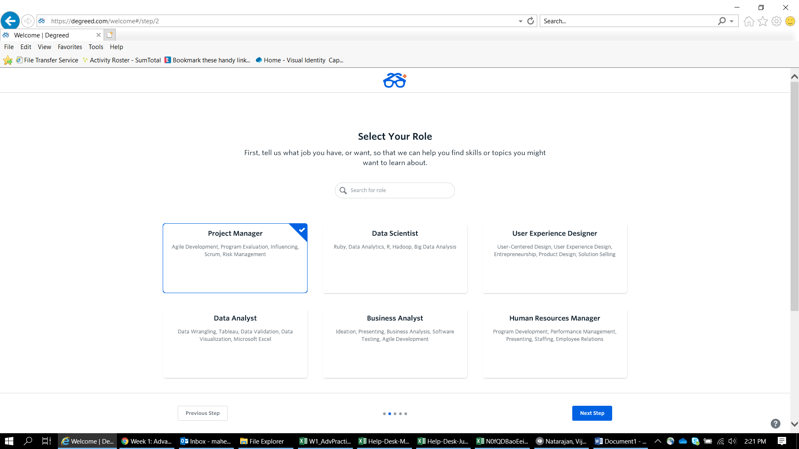
Step 2 – Create a Personal Profile

Slide 5
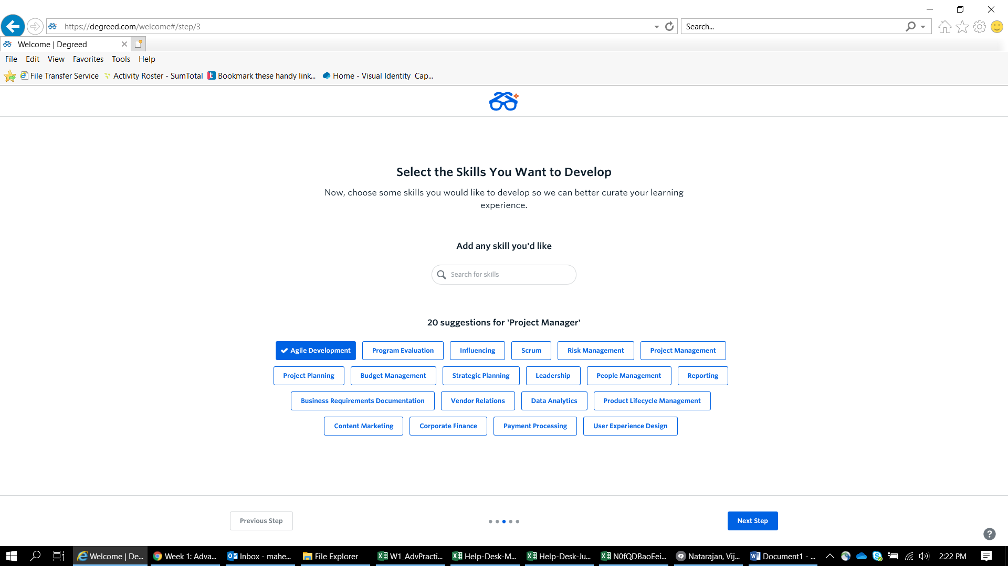
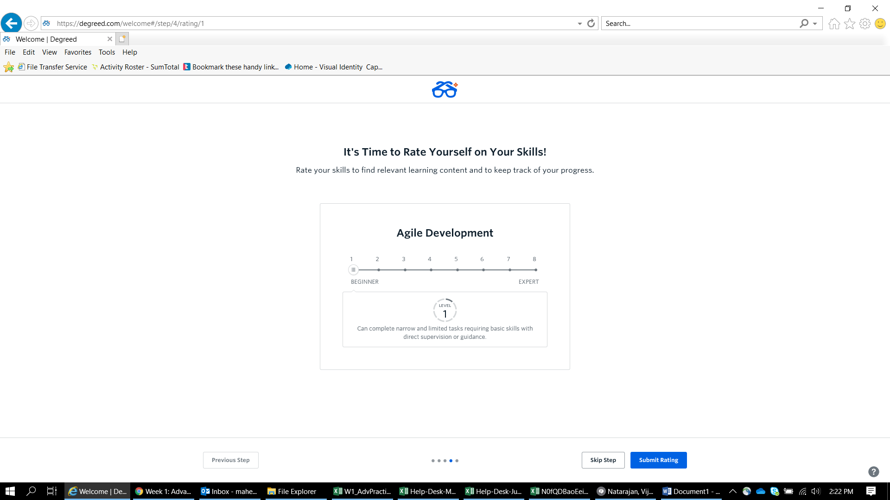
Further Steps

Slide 6
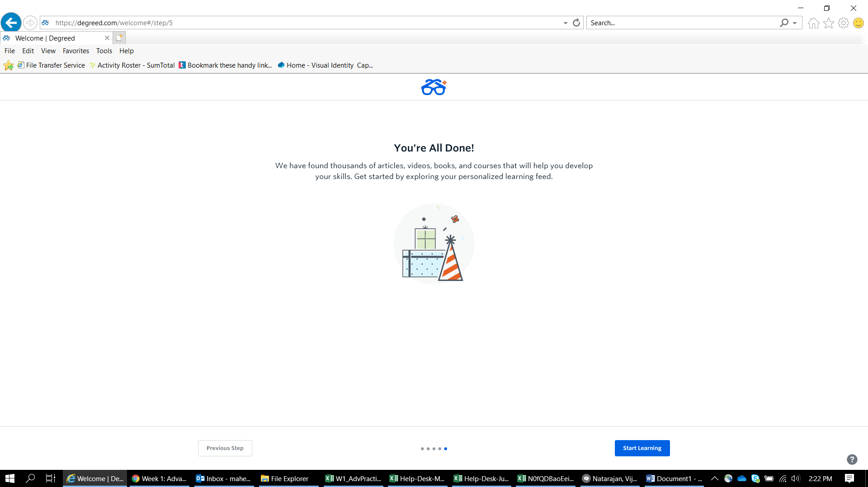
Yay!! Your Profile has been created on Degreed

Slide 7
Degreed Home Screen
Click on the Link(Check Email) or on the Highlighted area to access the course

Slide 8
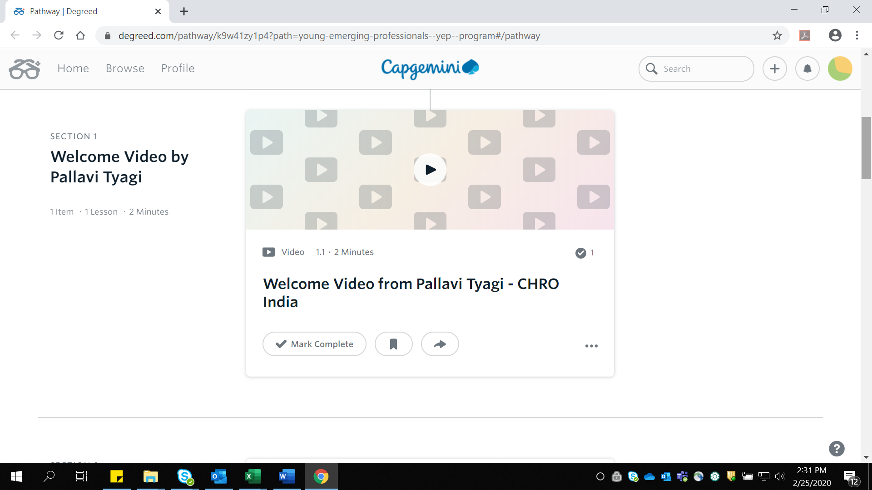
Step 5 – Your Exciting Learning Journey begins
Watch the video
Click on Mark Complete

Slide 9
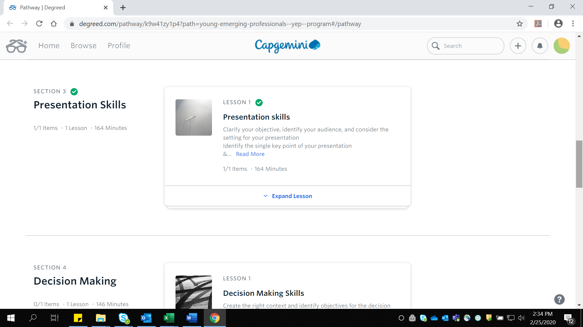
Step 6
Go to the next section. Click on Expand Lesson
Click here

Slide 10
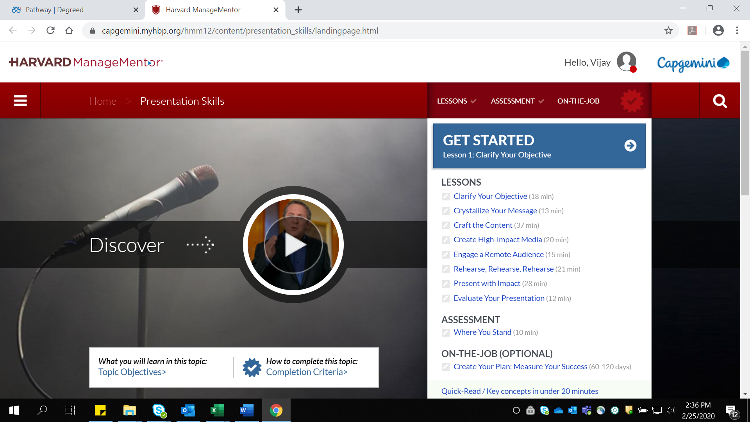
Step 7
Complete the lessons and the Assessment to proceed further

Slide 11
Tracking Progress
Track Progress

Slide 12
Queries and Issues
For any Queries and Issues, Contact
Your name – email ID – Vijay Natarajan – vijay.a.natarajan@capgemini.com
For Escalations, Contact
Pracheta Shivasubramanian - pracheta.shivasubramanian@capgemini.com

